Slide 1
Carpe Diem
Made by: Team Aldebaran
Abigail Lam | Leadership and Management
Hannah Maung | User Research and Communication
Kayla Hunter | UX Design and Prototyping
Benjamin Davidson | Writing and Deliverables
Prototype Link: Carpe Diem
https://www.figma.com/proto/MTyXdKqDHornhd86U0qzMb/Design-Gallery-Concept?node-id=123%3A79&scaling=scale-down&page-id=0%3A1&starting-point-node-id=123%3A79

Slide 2
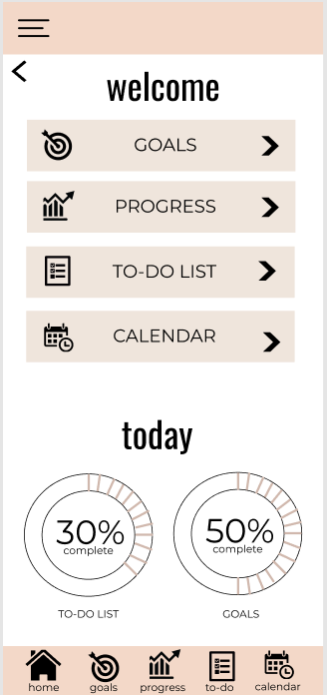
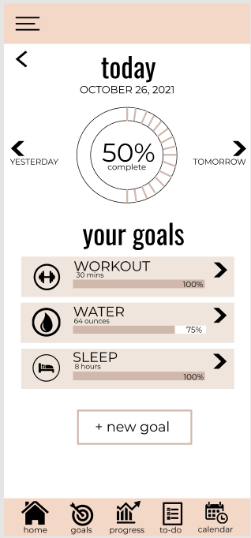
Dashboard
The dashboard is the first screen the user sees after they log in. This screen welcomes the user in addition to allowing users to navigate to the main features of the application (Goals, Progress, To-Do List, Calendar). It also shows the daily progress of the to-do list and goals.
User Research / Design Feedback:
Based on the usability test, users expressed difficulties on where to click to navigate to the desired page. The usability test showed users having to re-click different areas of the button multiple times.
Insights / Main Design Choices:
We added interactions for all areas of the button to navigate to the corresponding page. For the dashboard page, users are now able to click on the icon, the words (ex/ “GOALS” or “PROGRESS”), and the arrow.
Click the icon, words, or arrow to navigate to next page

Slide 3
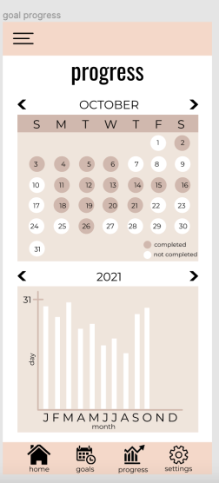
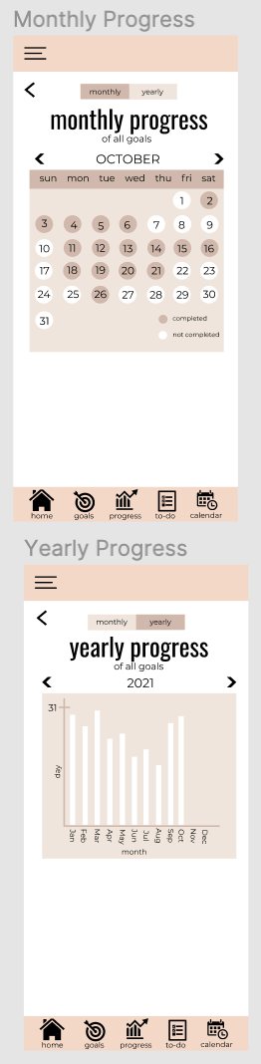
Goal Progress
The goal progress is split into monthly and yearly progress of all goals. The monthly progress page shows a calendar view that shows the days where all goals were completed. The yearly progress page shows a bar graph with the amount of days per month all goals were completed.
User Research / Design Feedback:
Users preferred having the graph labels written out instead of abbreviated. Many found it difficult to differentiate between days of the week and months since there were duplicate first initials (such as J for January, June, July).
User feedback also stated that one of the first iterations of the prototype was overloaded as we, the designers, were trying to use as much space on the screen as possible.
Insights / Main Design Choices:
On both the monthly and yearly graphs, we changed the labels to more accurately represent the day or month. For example, “Jan, Jun, Jul” makes it more easy to differentiate the months.
Instead of including just a progress page, we split them up into two pages in order to make the graphs easier to read and understand.
Before
After

Slide 4
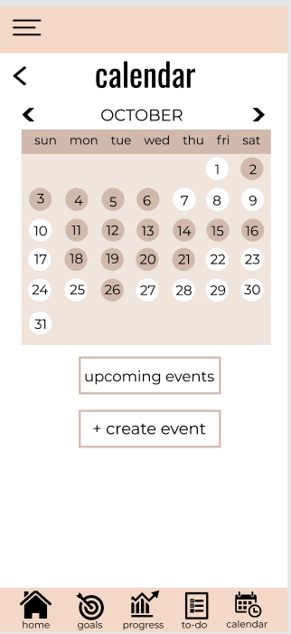
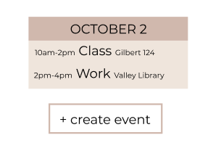
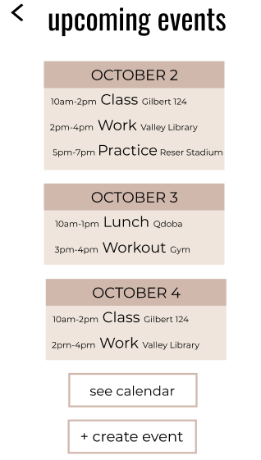
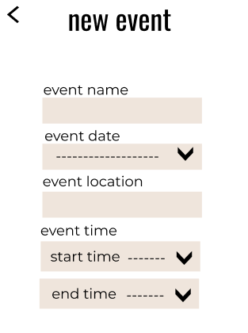
Calendar
When navigating to the Calendar page, there is the essential calendar. The dates that have events scheduled are filled in. When you click a specific date, the events for the day will appear. At the bottom of the screen, there are buttons to navigate to upcoming events and to create a calendar event.
User Research / Design Feedback:
Based on Usability Tests feedback, users wanted a more detailed calendar. Users wanted to be able to see all upcoming events instead of having to click each individual day.
Insights / Main Design Choices:
We added the option for users to see all upcoming events in addition to clicking on a specific date to see events. Additionally, users are able to create new calendar events with more detailed information.

Slide 5
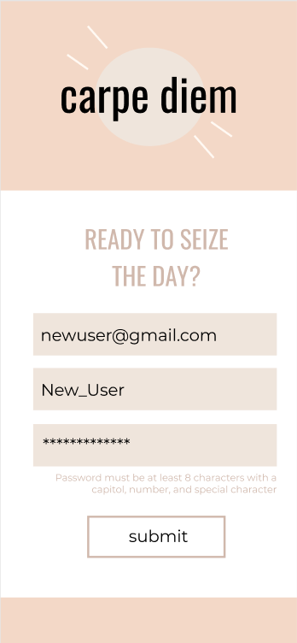
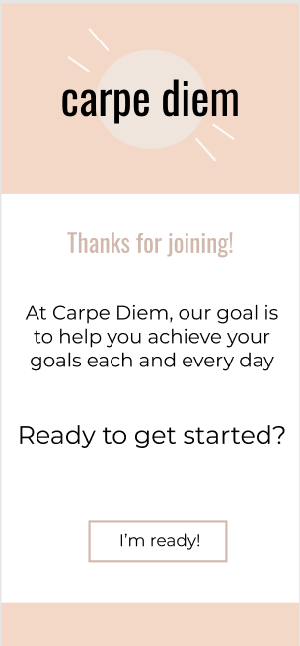
Landing page
This page is intended to convey to the user the purpose of the application. While an app store will also offer this info, the first time someone logs in they will want to recognize rather than recall what the product is for.
User Research / Design Feedback:
During an internal heuristic evaluation we noted a minor issue with help and documentation. Specifically, the app lacked any support touchpoints.
One peer reviewer stated, “Upon opening the application, I had to guess what the application was about”
Insights / Main Design Choices:
New users should see a landing page that describes what the app is for
Shown prior to the walk-through

Slide 6
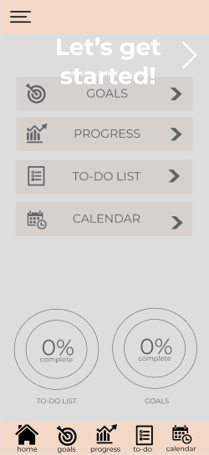
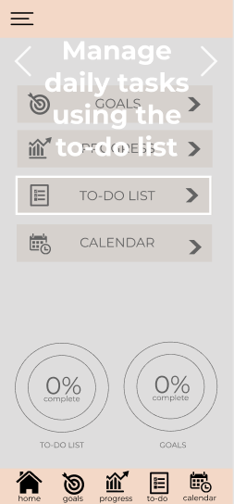
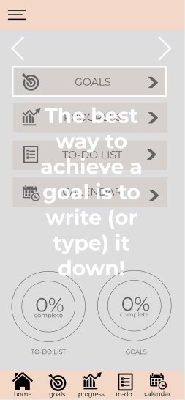
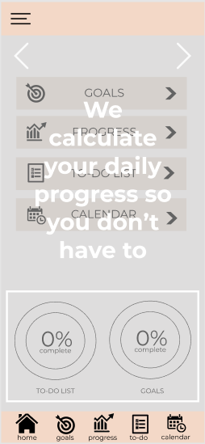
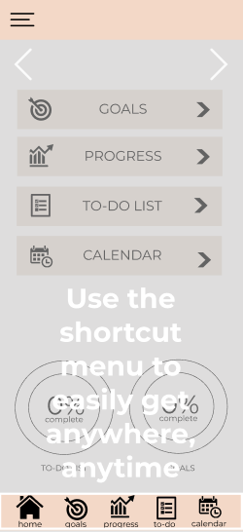
Walk-through
In an ideal world, a product is so intuitive that help documentation isn’t necessary. However, in most cases a brand new user might want an overview that guides them through getting started.
User Research / Design Feedback:
Heuristic evaluation revealed a lack of help documentation. “We should include proactive help which can walk new users through our app”
Peer feedback overwhelmingly cited not knowing how to use the app. “what the application is intended for and how to use the application, was missing”
Insights / Main Design Choices:
New users would benefit from an initial walk-through
Only shown after someone creates a new account

Slide 7
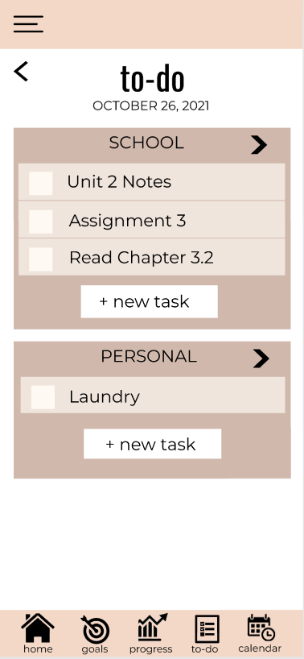
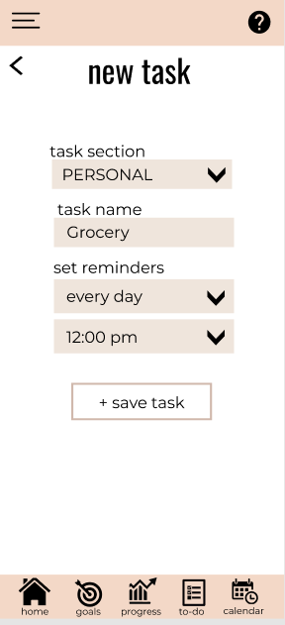
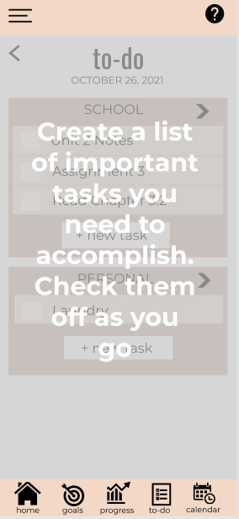
To-Do List
This page is dedicated for important tasks that users can keep track of and check off as they go. The to-do list is split up into different “tasks sections” so all the user’s tasks can stay categorized and organized. The user will be brought to the “new task” page which allows them to create a new task when they click on the “new task” button.
User Research / Design Feedback:
Users expressed their confusion on the difference between the To-Do list page and the Calendar items page
Users expressed the lack of help
Insights / Main Design Choices:
Added a message that explains the purpose of the to-do list to highlight the difference between the calendar events and tasks
Added a help button

Slide 8
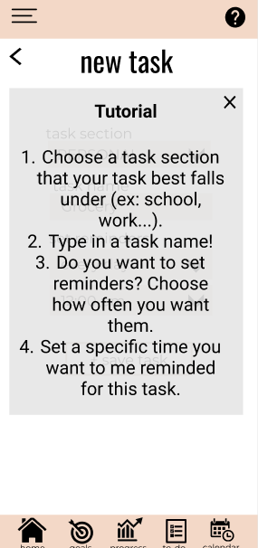
To-Do List- Adding a task
This page is designed to create a new task that will be added to the user’s To-Do list. They are able to choose a task section, task name, and frequency of reminders and a specific time.
User Research / Design Feedback:
Users expressed some confusion with creating a new task and suggested creating a “help” button or a tutorial for new users. They said the lack of help and clarity could result in frustration for new users.
Insights / Main Design Choices:
Added a “help” icon to the top right corner that users can click on to get a step by step tutorial that explains how to create a task. They can choose to refer back to it when confused.

Slide 9
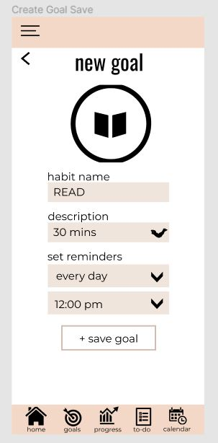
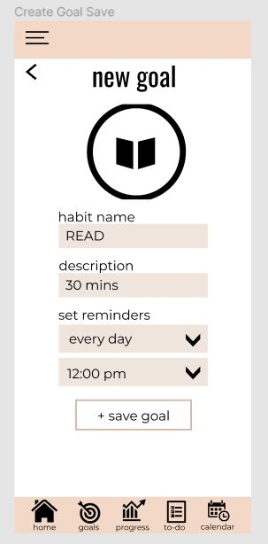
New Goal
This is the screen to add a new goal to the goals page. It is reached from the goals page. When you fill out all of the information and save the goal, then it returns you to the goal page.
User Research / Design Feedback:
There was not a lot of freedom when filling out fields such as description
Limited to drop down menus
Insights / Main Design Choices:
We took some of the drop down menus out
Replaced them with text fields
Now users can type in whatever they want for more fields
Before:
After:

Slide 10
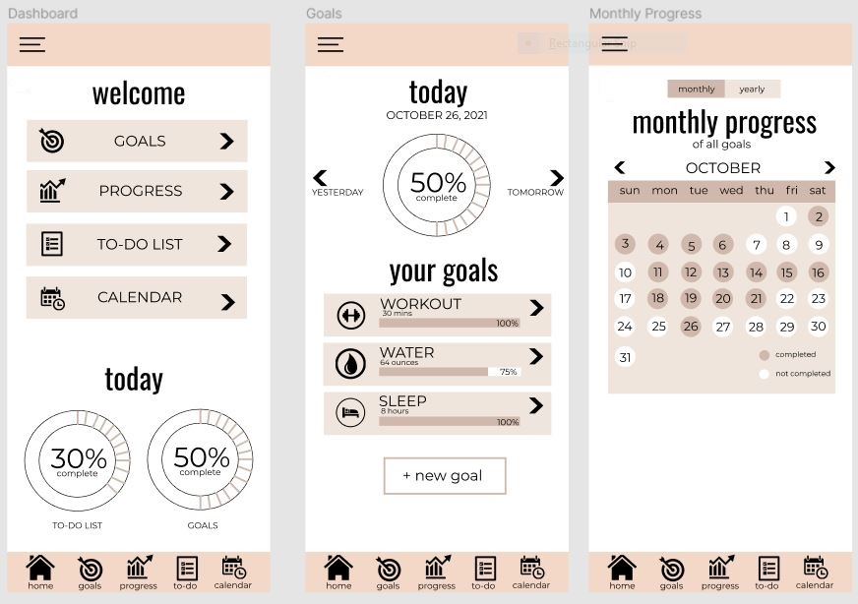
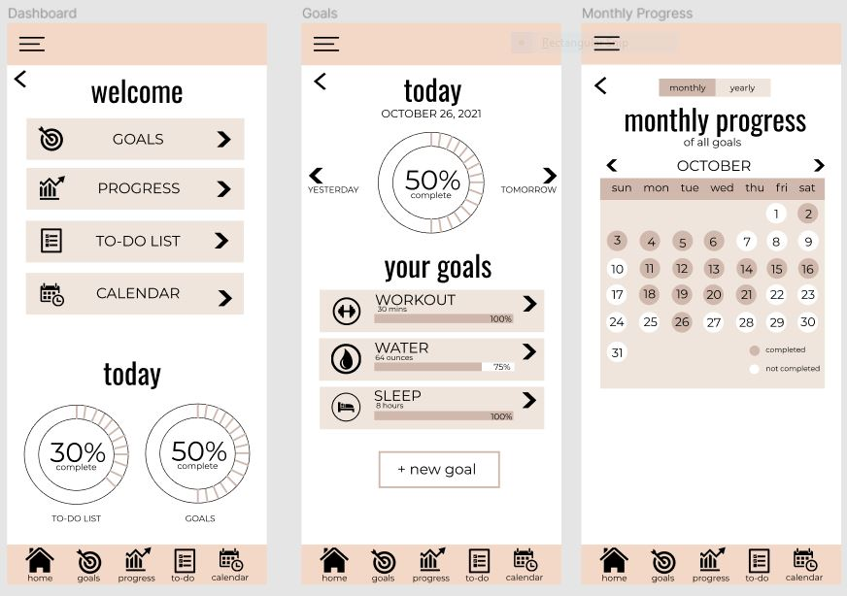
Before:
Dashboard / Goals / Progress
The dashboard is the first screen the user sees after they log in. The goals screen has an overview of your goals and the current day’s completion. The goal progress is split into monthly and yearly progress of all goals.
User Research / Design Feedback:
Users wanted to be able to go back to the previous screen
Our application did not have a back button on every page
Insights / Main Design Choices:
Implemented a back button on each screen
Made sure it was in the same spot on every screen, so users become familiar with where it is at
After:

